Slide 1
Digital Portfolio
STUDENT NAME: S.murugan
REGISTER NO AND NMID:24131090500121008 And 14C329B41E3D566941041545C9035DA8
DEPARTMENT: BCA
COLLEGE: COLLEGE/ Thiruvallur Arts AnD science College UNIVERSITY

Slide 2
PROJECT TITLE
Music Player Project

Slide 3


AGENDA
Problem Statement
Project Overview
End Users
Tools and Technologies
Portfolio design and Layout
Features and Functionality
Results and Screenshots
Conclusion
Github Link
3/21/2024 Annual Review

Slide 4

PROBLEM STATEMENT
Difficulty in finding a simple, lightweight, and customizable music player for web applications.

Slide 5

PROJECT OVERVIEW
A responsive web-based music player built using HTML, CSS, and JavaScript with basic controls (Play, Pause, Next, Previous, Progress Bar).

Slide 6

WHO ARE THE END USERS?
General users who want to listen to songs online.
Developers who want to integrate a simple player into their portfolio or projects.

Slide 7

TOOLS AND TECHNIQUES
Frontend: HTML, CSS, JavaScript
IDE/Editor: VS Code
Version Control: Git & GitHub

Slide 8
POTFOLIO DESIGN AND LAYOUT
Modern, clean UI with responsive design.
Album art, song title, artist display, and progress bar.
‹#›

Slide 9
FEATURES AND FUNCTIONALITY
Play/Pause, Next, Previous controls
Dynamic progress bar with seek option
Auto-play next track
Playlist support (optional)

Slide 10
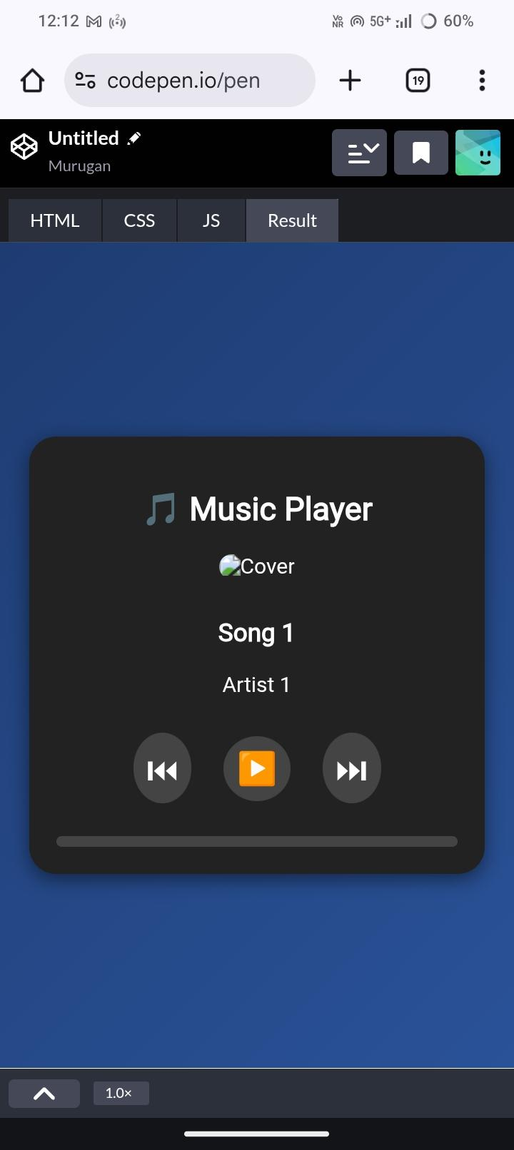

RESULTS AND SCREENSHOTS
3/21/2024 Annual Review
‹#›

Slide 11
CONCLUSION
Successfully developed a lightweight, user-friendly music player.
Can be enhanced with playlist UI, volume control, and shuffle/repeat features.
‹#›

